Slide 1
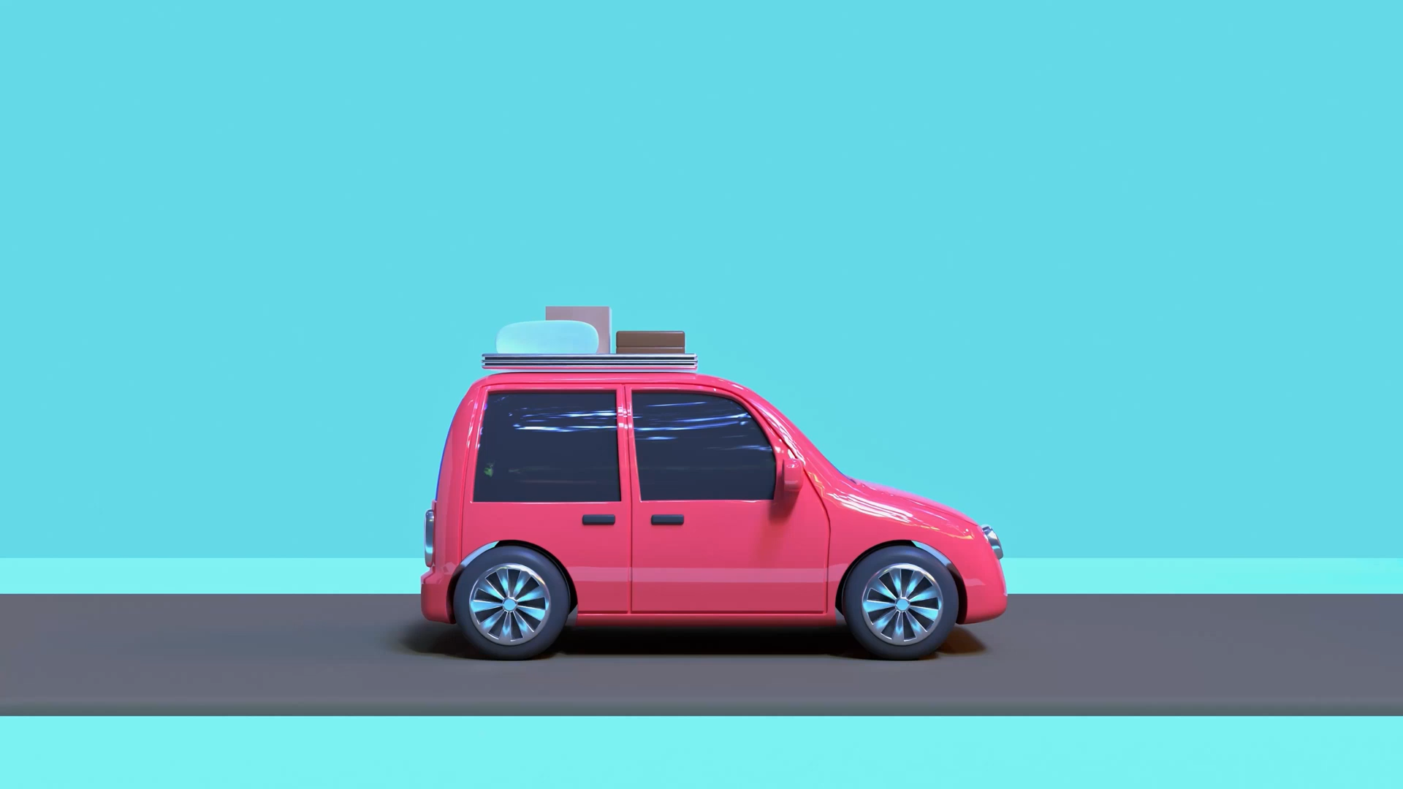
Mountain Car
Sara Sobstyl and Alicja Banaszewska

Slide 2
Description
This environment is part of the Classic Control suite

Slide 3
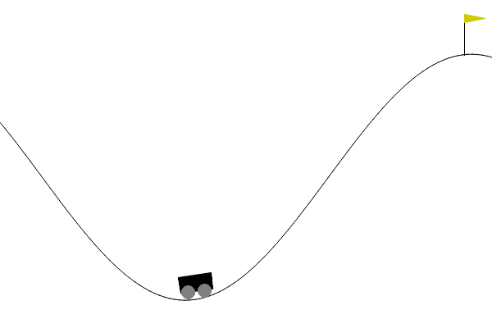
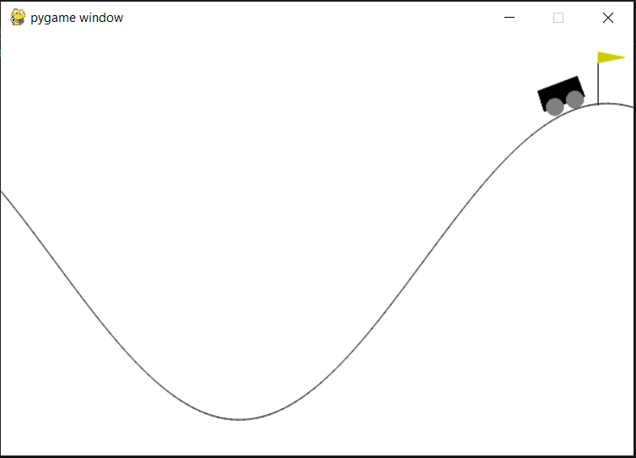
Goal
The goal of the MDP is to strategically accelerate the car to reach the goal state on top of the right hill.

Slide 4
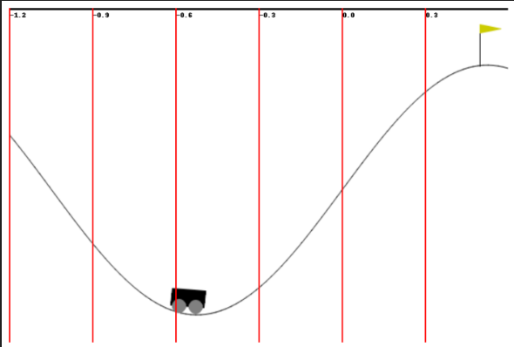
Observation Space
Index | Observation | Min | Max | Unit
0 | Car position (x-axis) | - 1.2 | 0.6 | Meters (m)
1 | Car velocity | -0.07 | 0.07 | Velocity (v)
Each observation is an array of two values:

Slide 5
Action Space
The agent can take one of three discrete actions:
0: Accelerate left
1: Coast (no acceleration)
2: Accelerate right

Slide 6
Transition Dynamics
Given an action, the environment updates according to:
velocity_{t+1} = velocity_{t} + (action - 1) * force - cos(3 * position_{t}) * gravity
position_{t+1} = position_{t} + velocity_{t+1}
Where:
force = 0.001
gravity = 0.0025
Velocity and position are clipped to their respective ranges. Collisions with boundaries reset velocity to 0.

Slide 7
Reward
Each timestep incurs a reward of -1 until the car reaches the goal

Slide 8
Starting State
At the beginning of an episode:
Position is randomly initialized between -0.6 and -0.4.
Velocity starts at 0.

Slide 9
Episode End
An episode terminates when:
The car’s position ≥ 0.5 (goal achieved), or
1000 steps have elapsed (timeout).

Slide 10
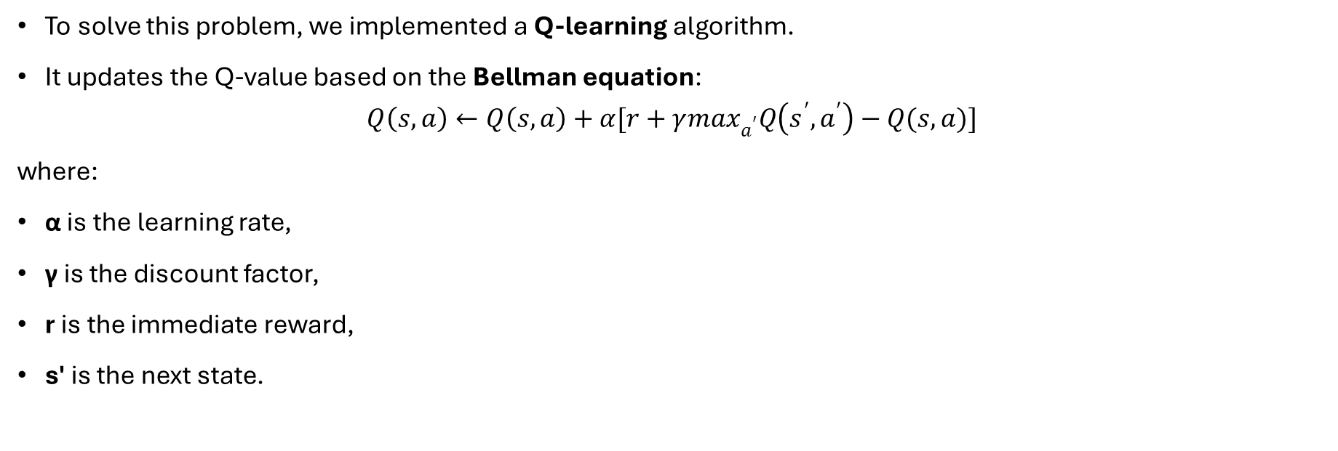
Algorithm
To solve this problem, we implemented a Q-learning algorithm.
It updates the Q-value based on the Bellman equation:
$$Q\left(s,a\right)←Q\left(s,a\right)+α[r+γ\max_{a^{′}}Q\left(s^{′}, a^{′}\right)−Q(s,a)]$$
where:
α is the learning rate,
γ is the discount factor,
r is the immediate reward,
s' is the next state.

Slide 11

Training

Slide 12
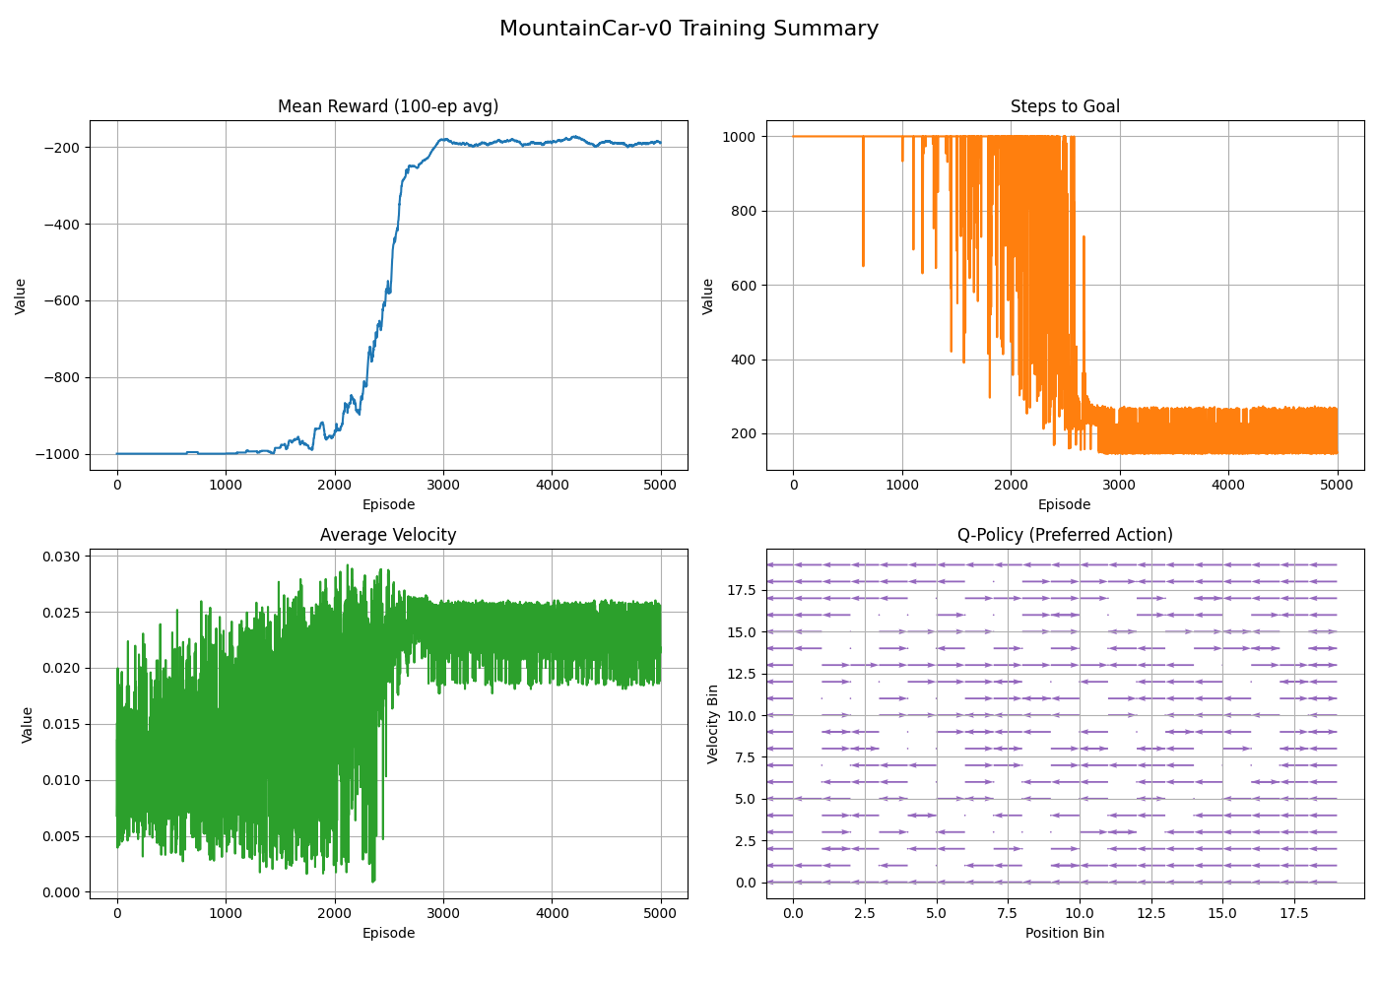
Graphs after learning with 5000

Slide 13
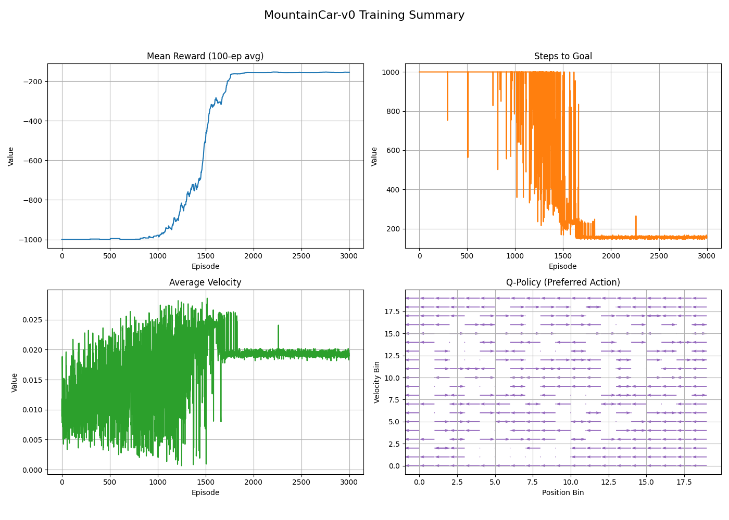
Graphs after learning with 3000

Slide 14
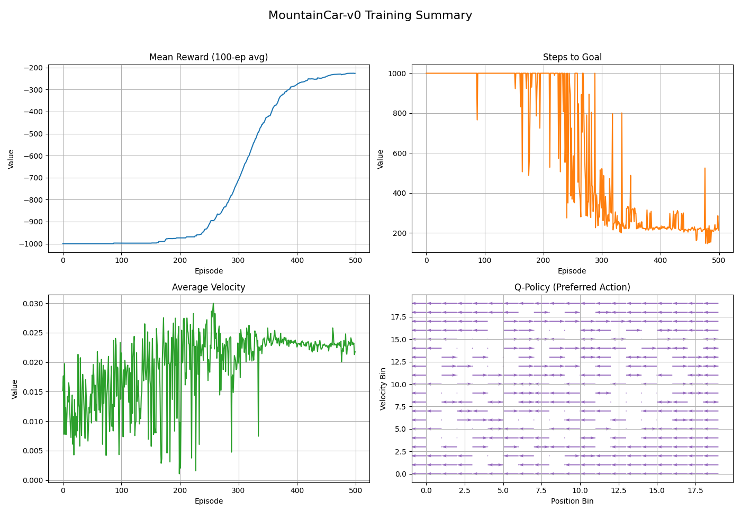
Graphs after learning with 500

Slide 15

Evaluation

Slide 16
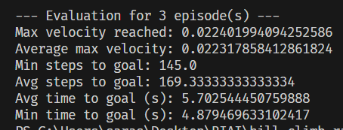
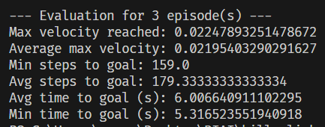
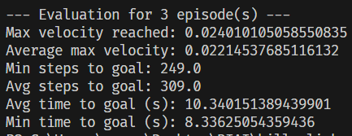
Evaluation for trained with 5000:
Evaluation for trained with 3000:
Evaluation for trained with 500:

